Slide 1

Project
It’s all about troubleshooting!!

Slide 2
Project
Task 1
To run an array sorting algorithm on Single-Cycle Processor
Select an array sorting algorithm
Write Assembly code for it and test it on the simulator
There is no need to run it as a function
In your assembly instructions, check which instructions are executable on the existing Single-Cycle Processor of lab 11
Either replace such instructions which are not executable in existing processor hardware with some simple instructions
For this you can modify assembly instructions/logic
Or, modify the hardware of RISC V to make such instructions executable
Such instr include (Slli, all branch instr other than beq)
Understand how BEQ works in single-cycle processor, then you can include some logic for other branches too

Slide 3
Project
Task 1
To array sorting algorithm on Single-Cycle Processor
Initialize instruction mem with your inst of bubble sort. You will have to increase size of ins mem
To do this, you may use Venus Kvakil carefully (convert the assembly into hex). One instruction consists of 8hex digits.
2 hex digits can be stored in one location of inst mem array
Kvakil uses lw. You need ld (load double word). So update lw inst hex code to get ld code manually
Base address of array can be 0 (in Kvakil there was a single memory for inst and data, so we had to use
Base address (0x100 , 0x200) to store arrays
No need to initialize an array using for loop. You can directly populate the array in Data Mem
Keep in mind, currently the data mem has 64 locations only, so at max it can store 8 elements (8B wide) unless you increase its size
Array length should be valid

Slide 4
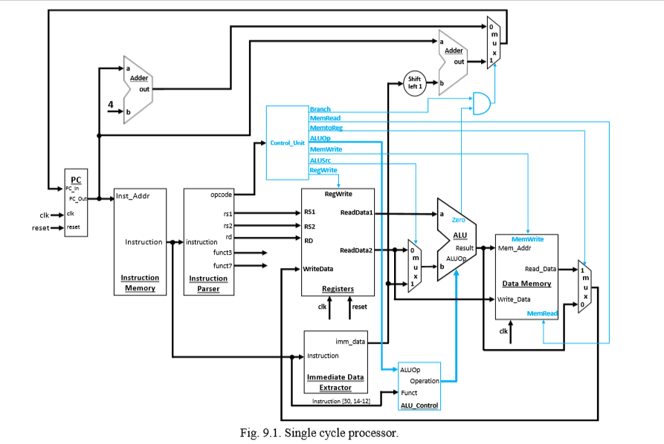

Slide 5
Project
Task 2
To implement pipelined processor
Refer to pages 2 and 3 of the project guidelines document
Implement pipeline registers as separate modules or by simply creating registers in the top module
Revise connections
Forwarding unit and its connections are shown
It can’t run all types of instructions right now as only the forwarding unit is added
Hazards that need stall or pipeline flush can’t be catered
So test the working of this pipelined processor for instructions that include data dependencies in R-type format only
Test cases matter!

Slide 6
Project
Task 3
To add stall and pipeline flush logics and run sorting algorithm on Pipelined processor
Refer to your textbook
Add functionality for stall and pipeline flush
Use simple test cases to check the working for stall and flush logic verification
Finally test the complete sorting algorithm on it!!

